Slide 1
Endless Runner
DRAFT
Setting & Moodboard & Characters

Slide 2
Time, time, time
Year: we are in the medieval times (Late Middle Ages)
Time of year: It is the end of a pleasant and lazy summer in the land of Lum. The first signs of fall are showing on the leaves. Farmers are preparing for harvest.
Time of day: The time varies throughout the course of the game starting at noon (with almost no shadows) and finishing at dusk (when you finally arrive at the King’s castle).

Slide 3
Movement
Ground
Jump
Change lanes
Turn corners
Slide
Using swipe gestures
Flying
Go up/down
Go left/right
Dodge left/right
Using accelerometer
Breathe fire (double tap)

Slide 4
3 Moments in the day
Broad daylight
Late afternoon (longer shadows)
Dusk/Sunset
Each one has a unique skybox.
The angle of the directional light changes
The baked vertex lighting is adapted also

Slide 5
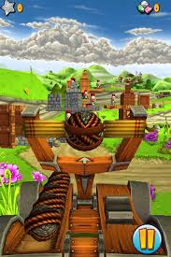
Broad daylight example

Slide 6
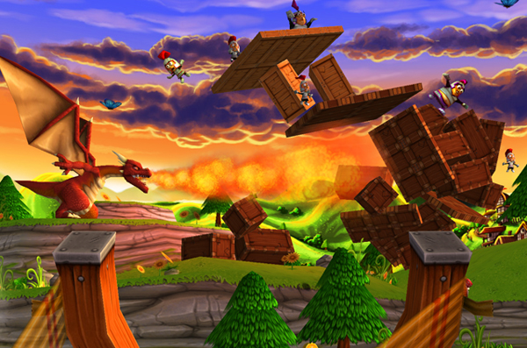
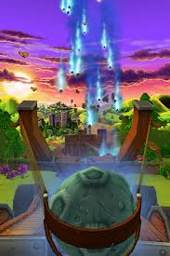
Sunset example

Slide 7
4 unique environments to explore
1 – Hilly Farmlands This is where you start
2 – Forest
3 – Swamp
4 – Mountains
Additional environments:
Castle City
This where you end. You do not enter the castle. You only cross the portcullis and the game ends. The castle is located on the mountain top.
Villages
Each village is a checkpoint. You only ever see the barricades and the entrance of the village. You do not run in or explore the village. In the village, you can shop via a GUI. This is also where the cute witch will give you magical powers.
Notes:
This section needs more work

Slide 8
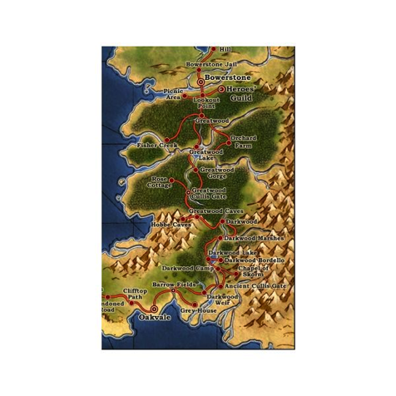
Progression Map
The player can see how he is progressing by consulting the world map. Each village or landmark is indicated. The map is also used to re-run certain sections to get the maximum number of stars (which is 3) for replay value.

Slide 9

Game Tone
The game does not take itself seriously. The tone is comical (think Catapult King, Army of Darkness, etc.)

Slide 10
Visual References
Main reference – Catapult King
This what we are shooting for
Second reference – Fable 2
Absolutly beautiful yet casual and accessible
Other reference:
Brothers: Tales of two sons and How to Train Your Dragon
Notes:
In order of importance

Slide 11
Catapult King

Slide 12
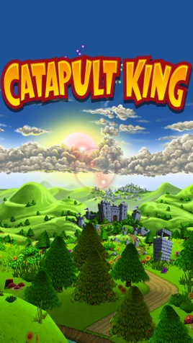
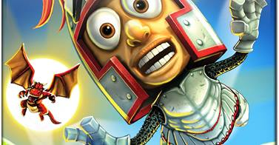
Catapult King

Slide 13

Catapult King

Slide 14
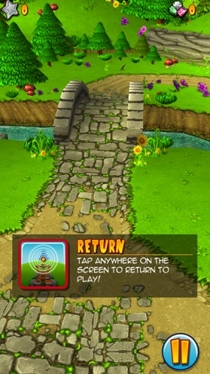
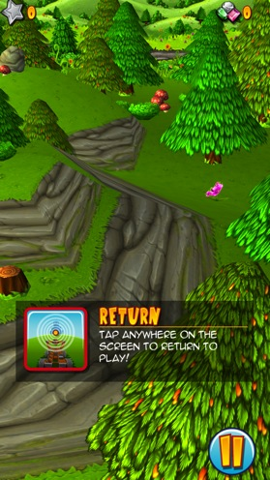
Road and trees

Slide 15
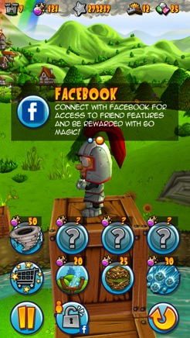
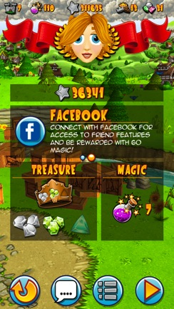
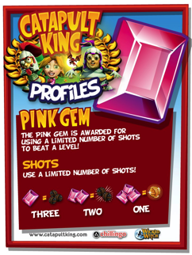
Icons & GUI & Font

Slide 16
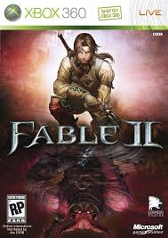
Fable 2

Slide 17
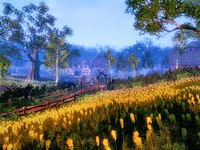
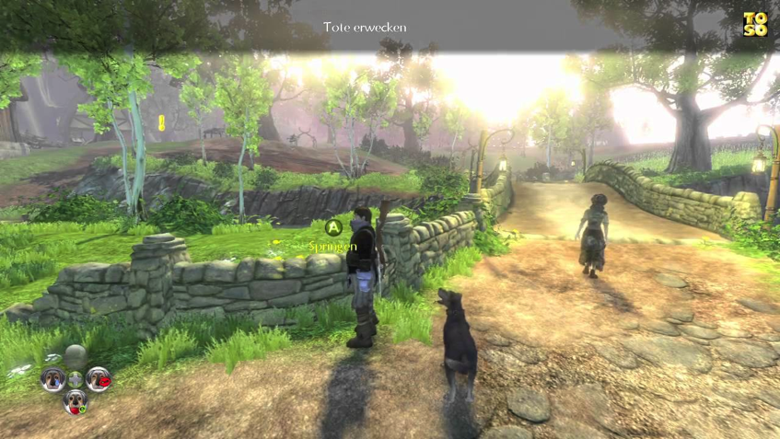
Fields and roads

Slide 18
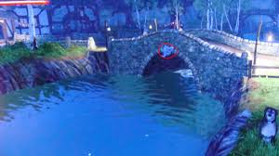
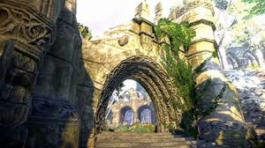
Stone and ruins

Slide 19
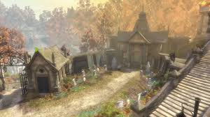
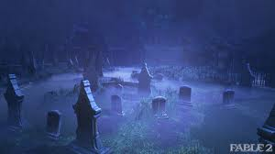
Cemetery

Slide 20
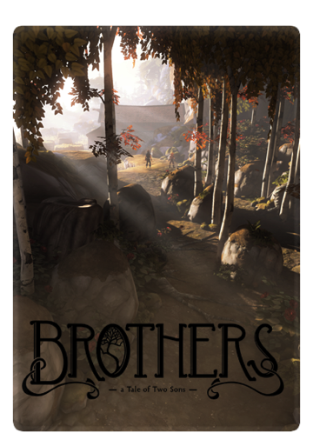
Brothers: A Tale of Two Sons

Slide 21
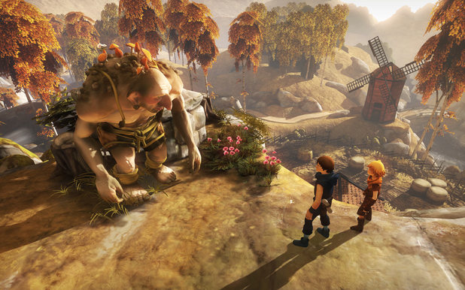
Autumn feeling
Notes:
Windmills

Slide 22
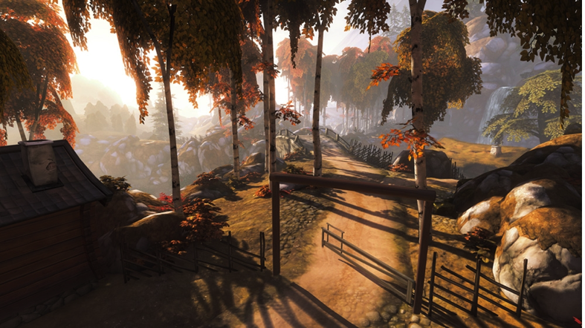
Roads

Slide 23
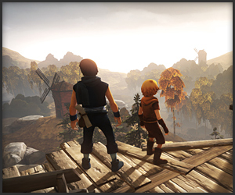
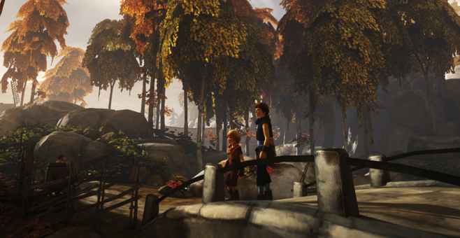
Wood bridge

Slide 24
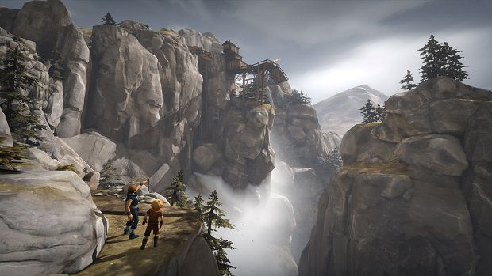
Mountains

Slide 25
How to train your dragon

Slide 26
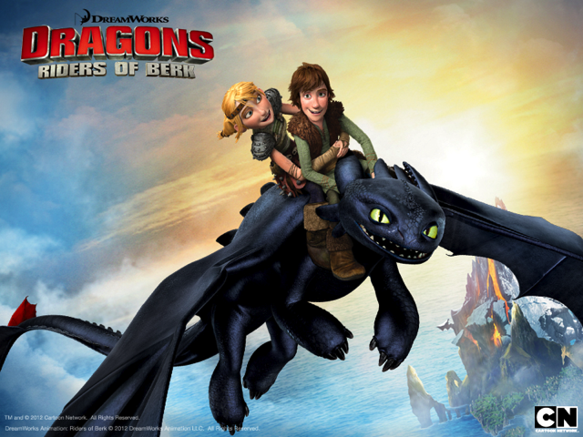
Riders of Bern

Slide 27
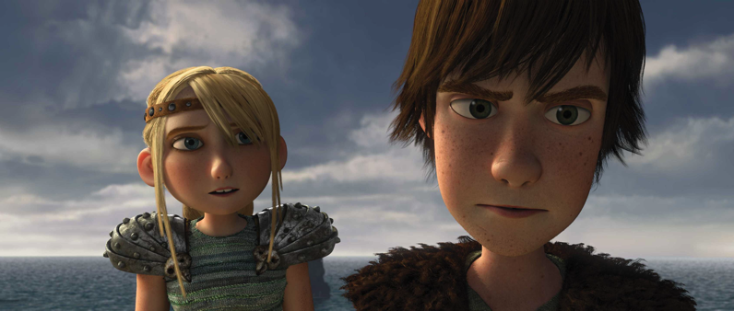
The heroes

Slide 28

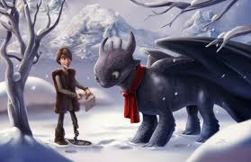
Funny little details

Slide 29
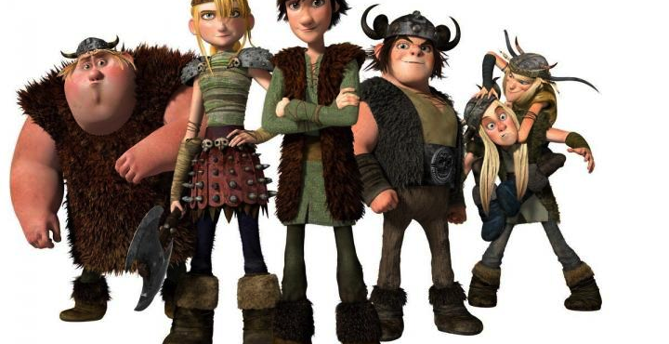
A Motley Crew

Slide 30
Environmental FX
Rain with puddles
Butterflies
Drifting pollen
Flying geese
Notes:
Rain with puddles – there is code and textures for that in the Angry Bot Unity package which I have

Slide 31
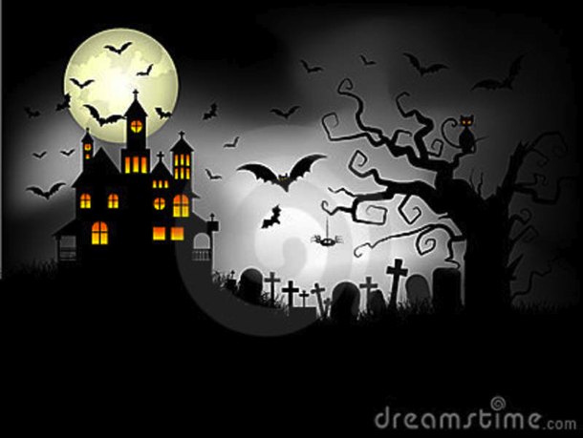
Lastly, a few areas can be spooky (Halloween style)

Slide 32
Characters

Slide 33
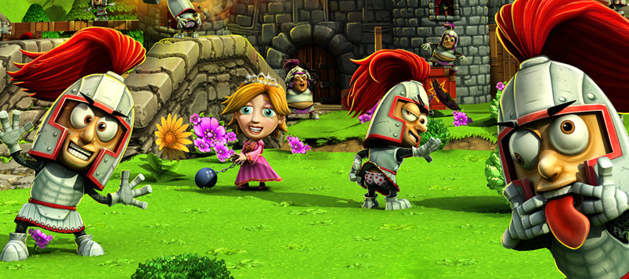
They have big heads & are silly

Slide 34
3 Main Characters
Hero – young guy between 15 and 25 working for the Medieval Postal Service
Cute witch – she rewards you with magical powers to help you along your journey when you arrive at each new checkpoint
Evil succubus – she hovers and attacks you from the sky. She has 4 attack modes: Flaming meteorite, Curse, Shazam, and Badaboum. She finds you (the hero) cute, sigh… but orders are orders and she must destroy you.

Slide 35
Secondary Characters
Goblin King – he is chasing you (along with 3 goblin minions). If you stumble twice in a row, he captures you
King of Lum – he congratulates you at the end
Peasant girl & boy – found in the farmland or in the villages
They may be blocking the road by crossing with a cow
They may be blocking two lanes with their cart (with a lantern flasher)
Goblin minion – they set traps (like roll a ball down a slope to block your passage)
Orc – not sure if needed
Village mayor – he congratulates you at each checkpoint
Villager girl & boy – found in villages (only there to make the village look inhabited)

Slide 36
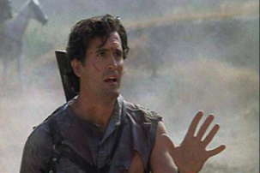
Hero
Our hero opens the Book of Demons and unleashes the Goblin hordes on the world, but he is now trying to do good by warning the villages to get ready for battle. He will race all the way to the King’s castle to warn him.

Slide 37
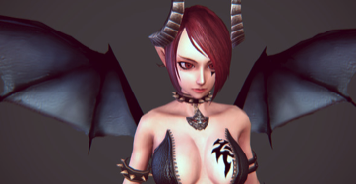
Succubus
She has 4 awesome powers:
Flaming meteorites – 5 Big, flaming meteorites fall randomly on the 3 lanes. The player must avoid them. If you receive one on the head or collide with one on the ground, you die.
Curse – The x-axis is reversed, confusing the player for 10 seconds (tilt left and you go right instead of left)
Shazam – a random funny object (like a chicken) appears in front of you. If you hit it, you stumble.
Badaboum – She causes a minor earthquake causing the camera to shake and the earth to tremble. Tap the icon that appears in time to avoid stumbling. Miss the icon completly and you fall on your face and the goblin hord captures you

Slide 38
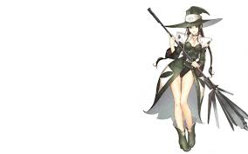
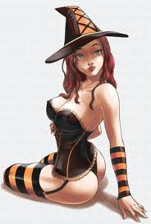
Cute witch
At each checkpoint, she helps the player by giving him a magical ability or by replenishing his supplies.

Slide 39
UNITY ASSET STORE

Slide 40
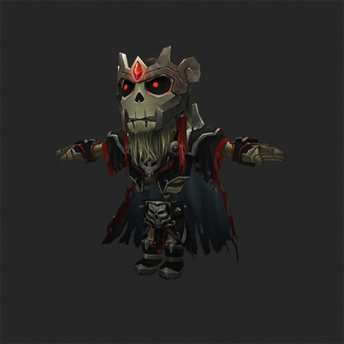
Skeleton King

Slide 41
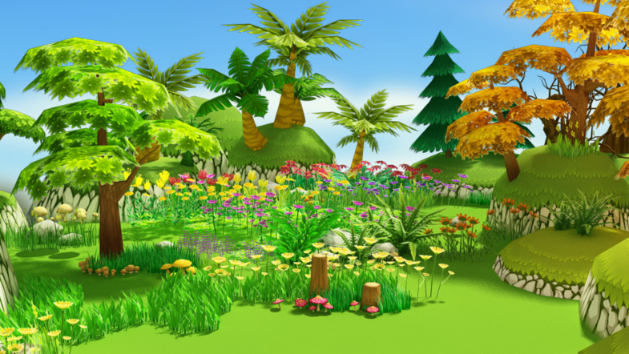
Cartoon Forest Pack

Slide 42
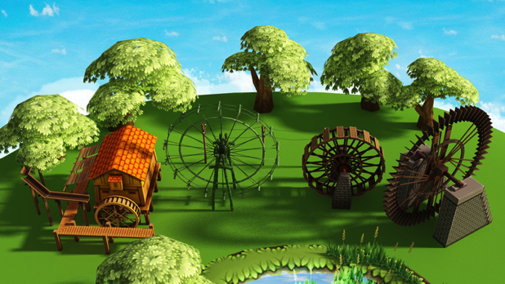

Water Wheel All Styles

